Slide 1

Spatial Role Labeling Task for SemEval 2012
Natural Language Processing for Massive Textual Data Management
Group Presentation

Slide 2
Outline
Introduction
Identification of Spatial Indicators
Identification of Trajectors and Landmarks
Jointly identification
Experiments
Conclusion

Slide 3
Outline
Introduction
Identification of Spatial Indicators
Identification of Trajectors and Landmarks
Jointly identification
Experiments
Conclusion

Slide 4
Introduction
Deal with the novel task of spatial role labeling in natural language text.
Extracting spatial roles and their relations:
Find spatial prepositions and then the related trajectors and landmarks.
Joint learning approach, where a spatial relation and its composing indicator, trajector and landmark are classified collectively.
Create triplets of <indicator, trajector, landmark>.

Slide 5
Introduction
Task A has to be treated sequentially into several sub-problems:
Identifying the pivot of the spatial relations learning to predict prepositions (Spatial Indicator).
Identify possible arguments of the spatial relations learning to predict trajectors and landmarks.
In task B we investigate another setting in which we classify all roles jointly (without separating classifications for spatial indicators and trajectors/landmarks.

Slide 6
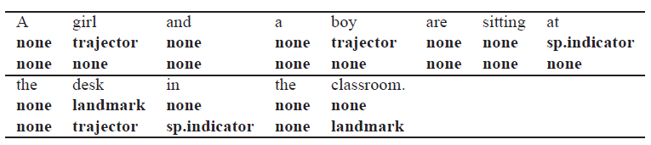
Introduction
Two examples of sentences labeled twice, each time with a different spatial indicator:

Slide 7
Outline
Introduction
Identification of Spatial Indicators
Identification of Trajectors and Landmarks
Jointly identification
Experiments
Conclusion

Slide 8
Identification of Spatial Indicators
Spatial information can be expressed primarily by using prepositions.
Task: classify prepositions on “SI” or “not SI” from these Features:
PREPOSITION
PREPOSITION_POS
(from dependency tree (Stanford Parser))
HEAD1: word directly dependent on the preposition
HEAD2: word on which the preposition is directly dependent
HEAD1_LEMMA (WordNet)
HEAD1_POS (Stanford Parser)
HEAD2_LEMMA (WordNet)
HEAD2_POS (Stanford Parser)
(from TPP dictionary)
PREP_SPATIAL: % of acceptions where preposition is spatial.

Slide 9
Identification of Spatial Indicators
Criteria taken to extract the features head1 and head2 is the left part of the SI and the right part of the SI, respectively.
We use Naïve Bayes classifier in order to see the probability of a preposition of being Spatial Indicator or not.

Slide 10
Outline
Introduction
Identification of Spatial Indicators
Identification of Trajectors and Landmarks
Jointly identification
Experiments
Conclusion

Slide 11
Identification of trajectors and landmarks
We aim to classify :
Features of a word:
Form, POS tag, dependency to the syntactic head in the dependency tree, semantic role, subcategorization.
Features of the spatial indicator:
Form, subcategorization.
Relational Features of the word with respecto to the SI:
Path, linear position.
We use Hidden Markov Models in order to see the probability of each word (with except to the SI) of being trajector, landmark or none.

Slide 12
Outline
Introduction
Identification of Spatial Indicators
Identification of Trajectors and Landmarks
Jointly identification
Experiments
Conclusion

Slide 13
Jointly Identification
Predict each triplet of segments indicator-trajector-landmark jointly.
Omitting the first task of predicting the spatial indicator.
Tagging words with trajector, landmark, SI or none.
Allows multiple words to be classified as SI.
We use HMM / AVERAGED PERCEPTRON? with another class “SI” added.

Slide 14
Outline
Introduction
Identification of Spatial Indicators
Identification of Trajectors and Landmarks
Jointly identification
Experiments
Conclusion

Slide 15
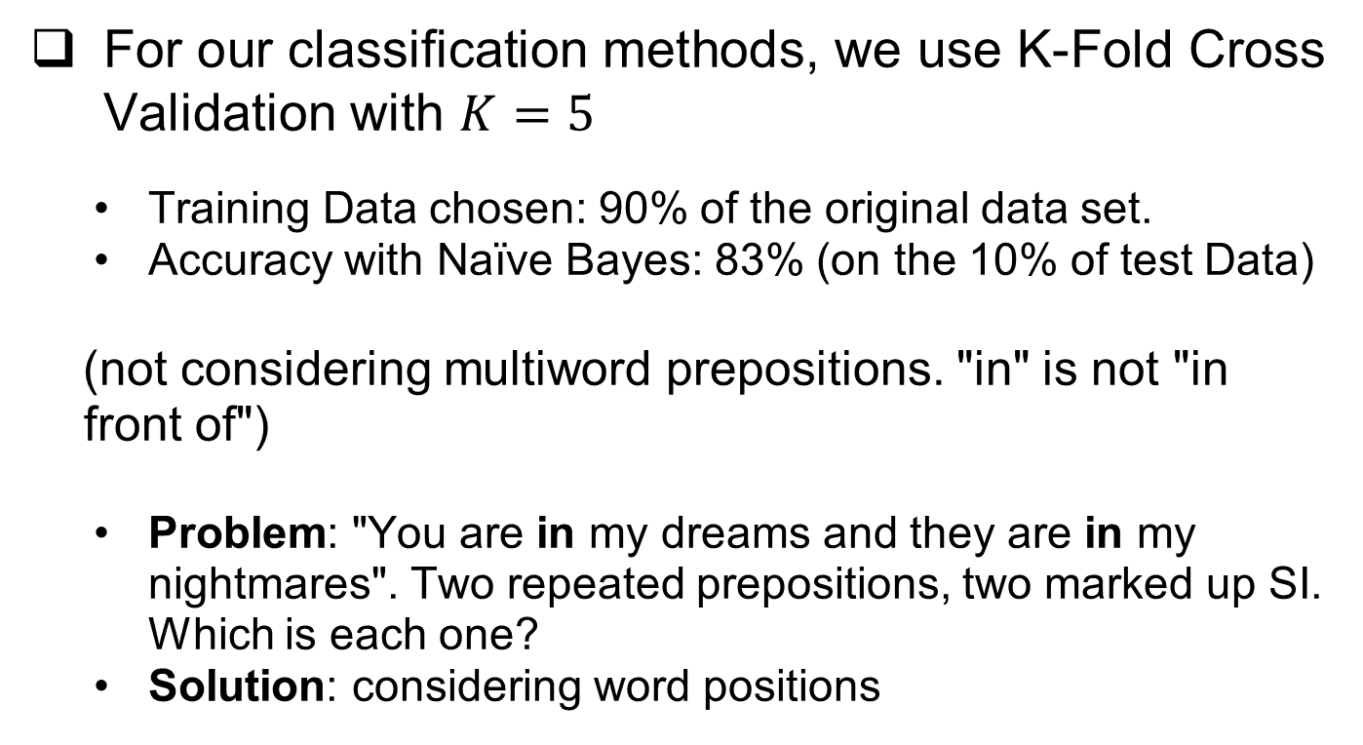
Experiments for SI identification
For our classification methods, we use K-Fold Cross Validation with $K=5$
Training Data chosen: 90% of the original data set.
Accuracy with Naïve Bayes: 83% (on the 10% of test Data)
(not considering multiword prepositions. "in" is not "in front of")
Problem: "You are in my dreams and they are in my nightmares". Two repeated prepositions, two marked up SI. Which is each one?
Solution: considering word positions

Slide 16
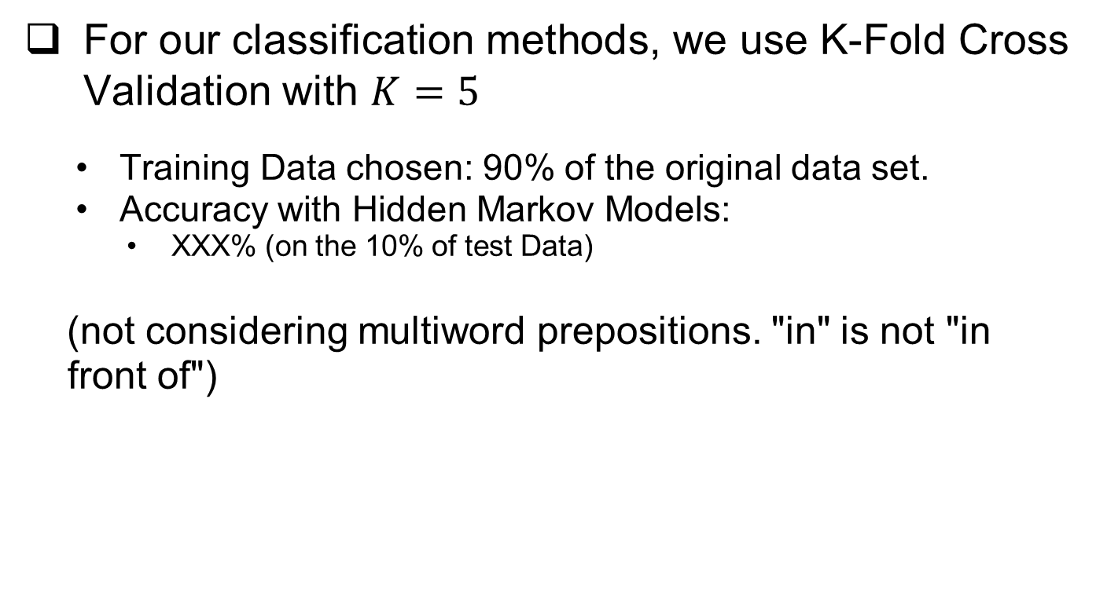
Experiments for Trajectors and Landmarks Identification
For our classification methods, we use K-Fold Cross Validation with $K=5$
Training Data chosen: 90% of the original data set.
Accuracy with Hidden Markov Models:
XXX% (on the 10% of test Data)
(not considering multiword prepositions. "in" is not "in front of")

Slide 17
Experiments for Jointly Identification
For our classification methods, we use K-Fold Cross Validation with $K=5$
Training Data chosen: 90% of the original data set.
Accuracy with Hidden Markov Models:
XXX% (on the 10% of test Data)
(not considering multiword prepositions. "in" is not "in front of")

Slide 18
Outline
Introduction
Identification of Spatial Indicators
Identification of Trajectors and Landmarks
Jointly identification
Experiments
Conclusion

Slide 19
Conclusion
f

Slide 20
References
[1] P. Kordjamshidi, M van Otterlo, and M. F. Moens. Spatial role labeling: task deﬁnition and annotation scheme. In LREC, 2010.
[2] P. Kordjamshidi, M van Otterlo, and M. F. Moens. From language towards formal spatial calculi. In Workshop on Computational Models of Spatial Language Interpretation (CoSLI 2010, at Spatial Cognition 2010), 2010.
[3] Parisa Kordjamshidi, Martijn van Otterlo, and Marie-Francie Moens. Spatial role labeling: Towards extraction of spatial relations from natural language. ACM Transactions on Speech and Language Processing, Nov. 2011. to appear.

Slide 21
Spatial Role Labeling Task for SemEval 2012
Thank you!

